Slide 1
Challenges
Final challenge

Slide 2
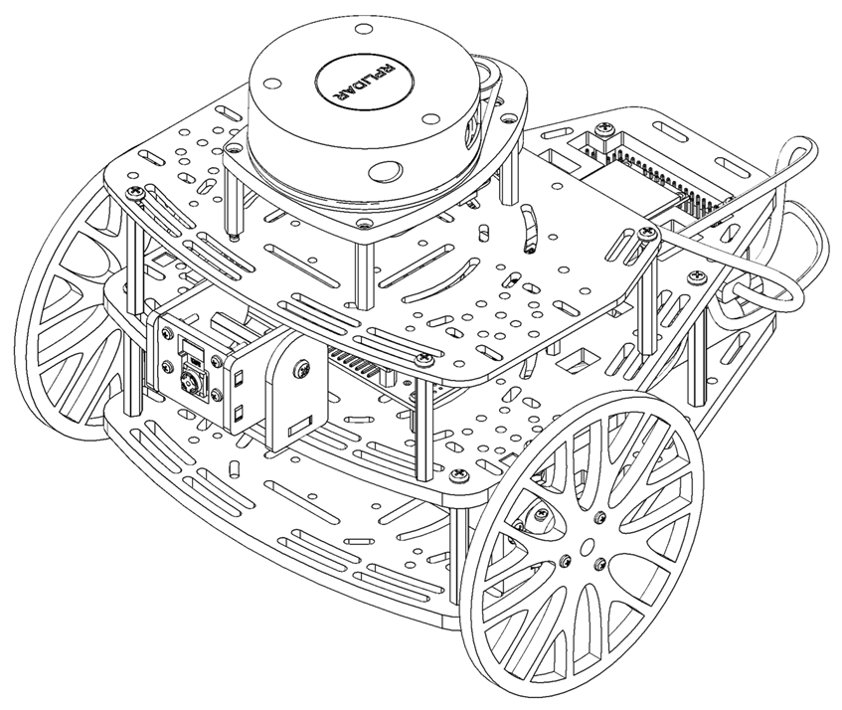
Final Challenge
This challenge is intended for the student to review the concepts introduced in this week.
This challenge aims to show the behaviour of the closed loop control in robotics.
This challenge will be divided in different sections.

Slide 3
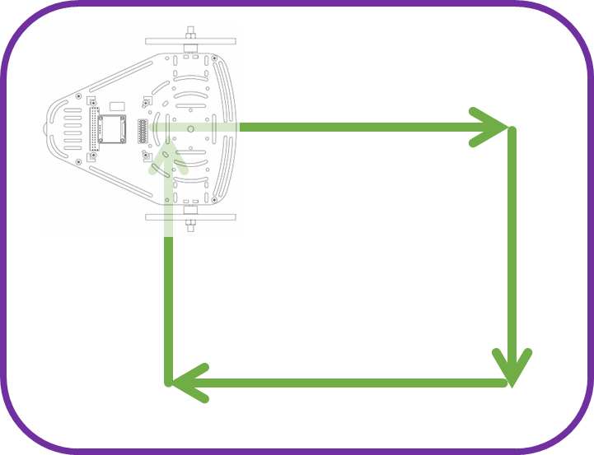
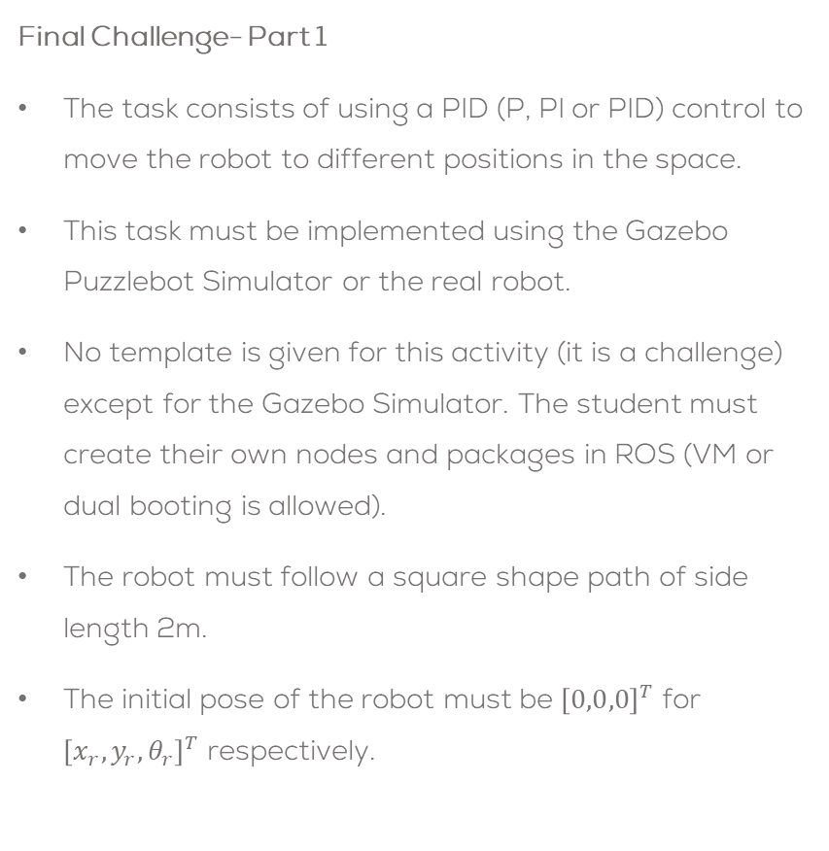
Final Challenge
Final Challenge- Part 1
The task consists of using a PID (P, PI or PID) control to move the robot to different positions in the space.
This task must be implemented using the Gazebo Puzzlebot Simulator or the real robot.
No template is given for this activity (it is a challenge) except for the Gazebo Simulator. The student must create their own nodes and packages in ROS (VM or dual booting is allowed).
The robot must follow a square shape path of side length 2m.
The initial pose of the robot must be ${\left[0,0,0\right]}^{T}$ for ${\left[x_{r},y_{r},θ_{r}\right]}^{T}$ respectively.

Slide 4
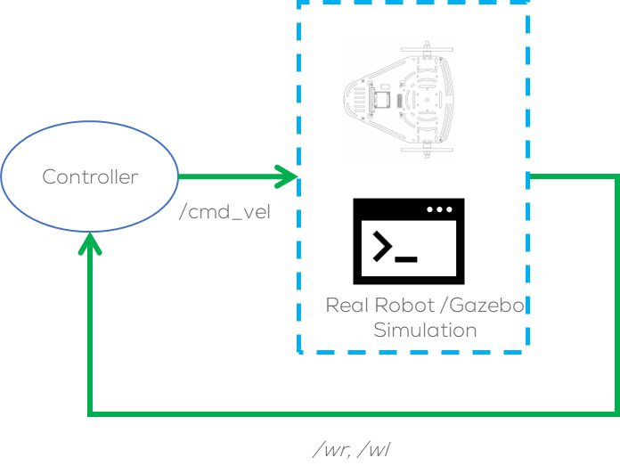
Final Challenge
The closed loop controller must be robust.
The student must define what is robustness and implement strategies to achieve it with the controller.
The controller must be tunned properly.
The controller must take into consideration, perturbation, nonlinearities and noise.
It is encouraged, but not required, for the student to use a config file or a parameter in the launch file to establish the goal targets such that they can be changed outside the code (not hardcoded).

Slide 5
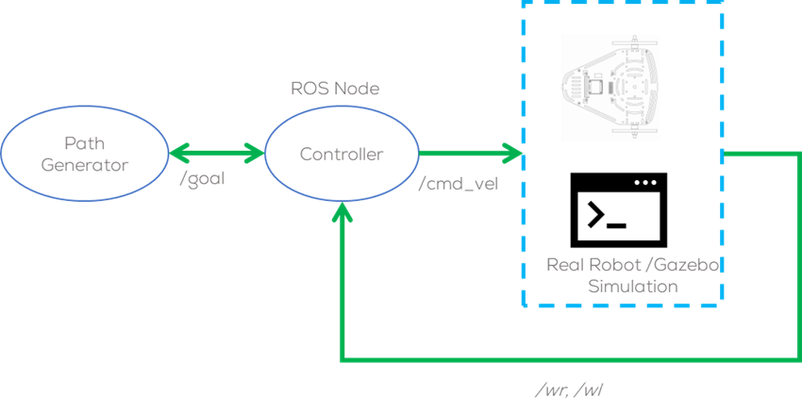
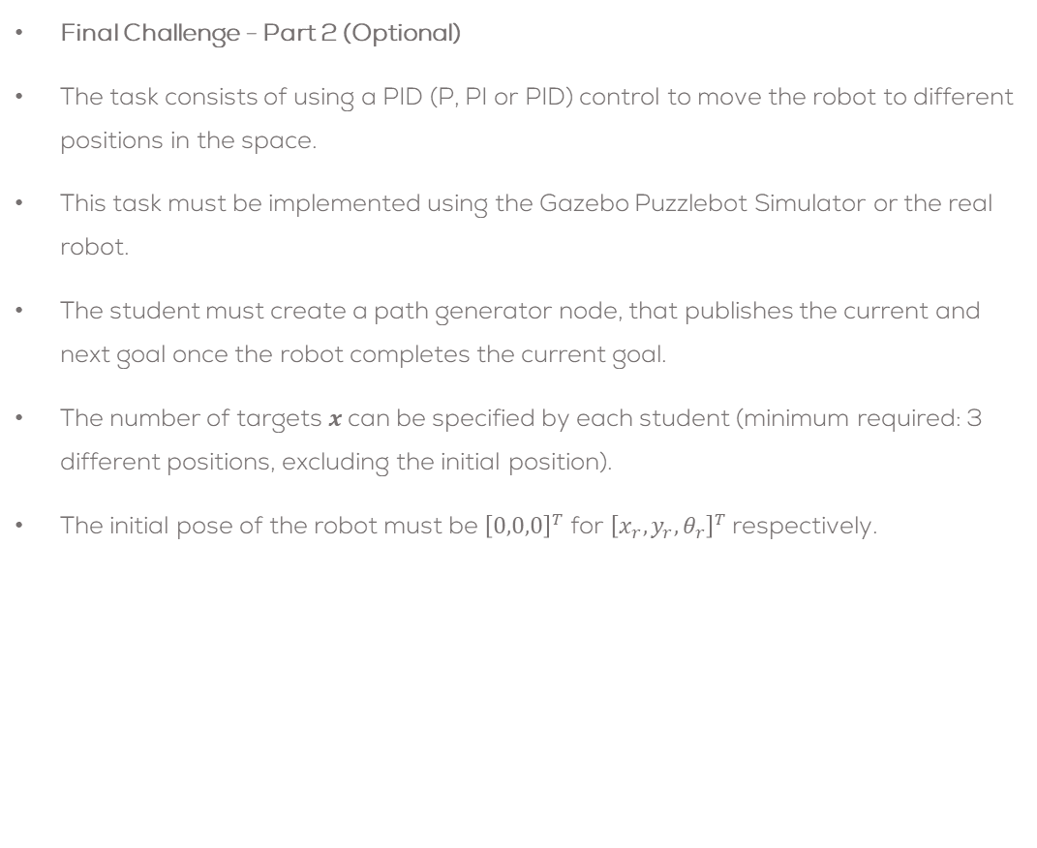
Final Challenge (optional)
Final Challenge - Part 2 (Optional)
The task consists of using a PID (P, PI or PID) control to move the robot to different positions in the space.
This task must be implemented using the Gazebo Puzzlebot Simulator or the real robot.
The student must create a path generator node, that publishes the current and next goal once the robot completes the current goal.
The number of targets $x$can be specified by each student (minimum required: 3 different positions, excluding the initial position).
The initial pose of the robot must be ${\left[0,0,0\right]}^{T}$ for ${\left[x_{r},y_{r},θ_{r}\right]}^{T}$ respectively.

Slide 6
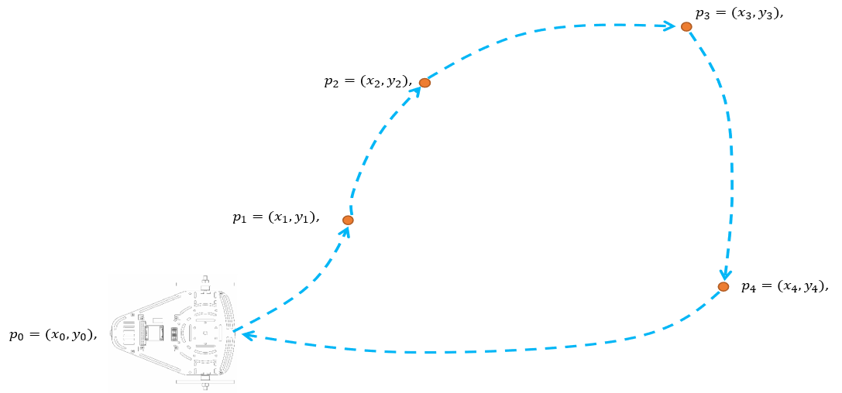
Final Challenge (optional)
The closed loop controller must be robust.
The student must define what is robustness and implement strategies to achieve it with the controller.
The controller must take into consideration, perturbation, nonlinearities and noise.
The controller must be tunned properly.
It is encouraged, but not required, for the student to use a config file or a parameter in the launch file to establish the goal targets such that they can be changed outside the code (not hardcoded).

Slide 7
Deliverables
The student must submit a video showing their results.
Duration: Under 4 min. (If longer, increase speed)
Show face, name and student ID number.
Video on YouTube (Unlisted)
Video in English
Tasks
Brief introduction (problem to be solved, solution strategy, team tasks, etc.)
Explain how the program works (launch files, libraries made, the structure of the project, etc.)
Show the results of the root being controlled, and the methodology followed to solve it.
Explain briefly the block diagram of the implemented algorithm.
Analysis of the robot’s behaviour. What is expected? Is the behaviour good? Why? Advantages/disadvantages of this type of control? Problems with this type of control?
A brief set of conclusions from the task.

Slide 8
Rules
This is challenge not a class. The students are encouraged to research, improve tune explain their algorithms by themselves.
MCR2(Manchester Robotics) Reserves the right to answer a question if it is determined that the questions contains partially or totally an answer.
The students are welcomed to ask only about the theoretical aspect of the classed.
No remote control or any other form of human interaction with the simulator or ROS is allowed (except at the start when launching the files).
It is forbidden to use any other internet libraires with the exception of standard libraires or NumPy.
If in doubt about libraires please ask any teaching assistant.
Improvements to the algorithms are encouraged and may be used as long as the students provide the reasons and a detailed explanation on the improvements.
All the students must be respectful towards each other and abide by the previously defined rules.
Manchester robotics reserves the right to provide any form of grading. Grading and grading methodology are done by the professor in charge of the unit.

